Slide 1
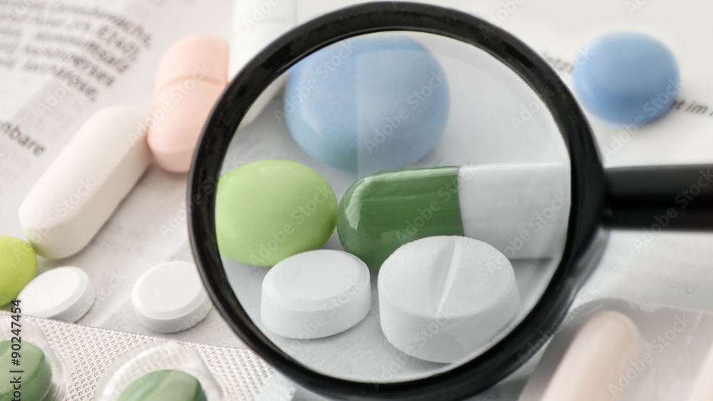

Lachoo Memorial College of Science and Technology, Jodhpur
Affiliated to
Jai Narayan Vyas University
Scope of Pharmacovigilance in India
Supervised by:
Mrs. Ruchi Agarwal
(Assistant Professor)
(Department of Pharmaceutical Chemistry)
Presentation by:
Bharat Solanki , Bhavesh Mewara And
Yuvraj Singh

Slide 2
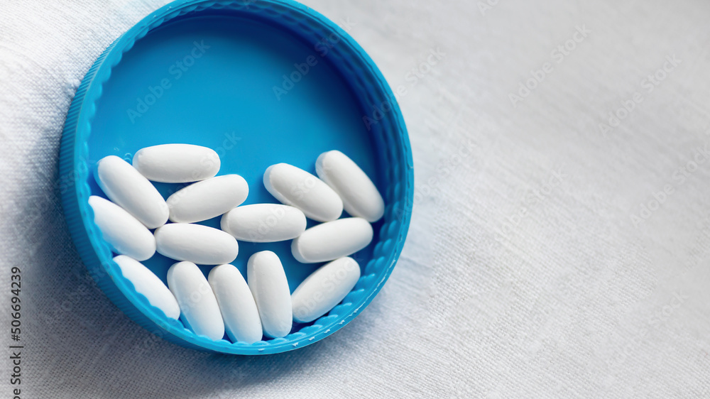
INTRODUCTION
Pharmacovigilance (PV) was officially introduced in December1961
Pharmacovigilance is an important and integral part of clinical research
Pharmacovigilance (PV) also known as drug safety, is the pharmaceutical science relating to the "collection, detection, assessment, monitoring, and prevention" of adverse effects with pharmaceutical products.

Slide 3
SCOPE OF PHARMACOVIGILANCE
To create a nationwide system for patient safety reporting.
To identify and analyze new signals from the reported cases.
To analyze the benefit-risk ratio of marketed medications.
To generate evidence-based information on the safety of medicines.
To support regulatory agencies in the decision-making process on the use of medications.
To communicate the safety information on the use of medicines to various stakeholders to minimize the risk.
To emerge as a national center of excellence for pharmacovigilance activities.
To collaborate with other national centers for the exchange of information and data management.
To provide training and consultancy support to other national pharmacovigilance centers across the globe.
To identify and analyze new ADR signals from the reported cases.
To promote rational use of medicines.

Slide 4
PHARMACOVIGILANCE METHODS
There are several pharmacovigilance methods followed in recording adverse events related to drugs. The methods are as follows:
(i) Passive surveillance
(ii) Stimulated reporting
(iii) Active surveillance
(iv) Comparative observational studies
(v) Targeted clinical investigations
(vi) Descriptive studies

Slide 5

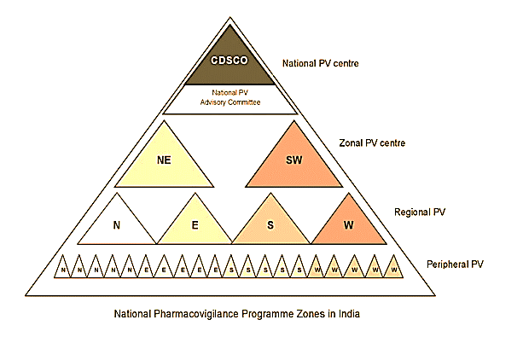
PHARMACOVIGILANCE IN INDIA
The Central Drug Standard Control Organization (CDSCO), New Delhi, under the control of the Ministry of Health and Family Welfare, the Government of India initiated a nationwide pharmacovigilance program in July 2010. All Institute of Medical Sciences (AIIMS), New Delhi was the National Co-ordinating Centre (NCC) for monitoring ADRs. Since April 2011, the Indian Pharmacopoeia Commission (IPC),Ghaziabad looks after administrative matters related to NCC. 22 ADR monitoring centers (AMCs) have been established throughout India.
National PV Center
Zonal PV Center
Regional PV
Peripheral PV
NATIONAL PHARMACOVIGILANCE PROGRAMME ZONES IN INDIA

Slide 6
Clinical Trials In India
Global pharmaceutical companies have found India to be a preferred destination for clinical trials because India's clinical research space and opportunities are very attractive. Some of the advantages for clinical trials that India has as are as follows:
High degree of compliance to international guidelines such as the International Conference on Harmonization (ICH) / WHO Good Clinical Practice (ICH-GCP) and the regulations laid down by the US Food and Drug Administration.
Availability of well qualified, English speaking research professionals including physicians.
Ongoing support and cooperation from the government.
Lower cost compared to the west.
Increasing prevalence of illnesses common to both developed and developing countries.
Availability of good infrastructure.
Changes in Patent Laws since January 2005.

Slide 7
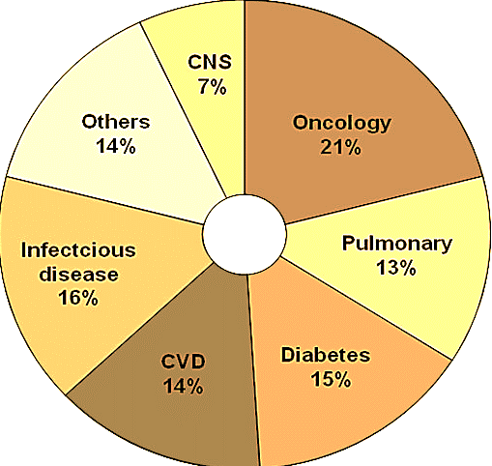
As per a recent report from Federation of Indian Chambers of Commerce and Industry (FICCI), scientific feasibility, medical infrastructure, clinical trial experience, regulations, commercialization potential and cost competitiveness are some of the growth drivers responsible for the metamorphosis of Indian clinical research in the recent past ^{[15].} Indian-born contract research organizations (CROs) were able to offer the advantages of understanding the Indian scenario better, provide services at more competitive costs, and having better knowledge of Investigator sites in the country compared to the newer entrants in the market. India’s existing favorable regulatory framework and regulations with international standards, increasing awareness of good clinical practice guidelines and its implementation by clinicians are some of the main reasons propelling the growth of clinical research in India. The therapeutic area wise distribution of clinical trials and availability of diverse patient population across major therapeutic segments in India
Therapeutic area wise distribution of clinical trials outsourced to India.

Slide 8
Data Mining for PV
PV, also known as drug safety surveillance, is the science of enhancing patient care and patient safety regarding the use of medicines by collecting, monitoring, assessing, and evaluating information from healthcare providers and patients. In that view, PV can be divided into two stages such as premarketing surveillance – information regarding ADRs is collected from pre-clinical screening and phases I to III clinical trials; and post-marketing surveillance – data accumulated in the post approval stage and throughout a drug’s market life.
PV has relied on biological experiments or manual review of case reports; however, due to the vast quantities and complexity of data to be analyzed, computational methods that can accurately detect ADRs in a timely fashion have become a critical component in PV. Large-scale compound databases containing structure, bioassay, and genomic information, as well as comprehensive clinical data sets such as electronic medical record (EMR) databases, have become the enabling resources for computerized ADR detection methods.

Slide 9
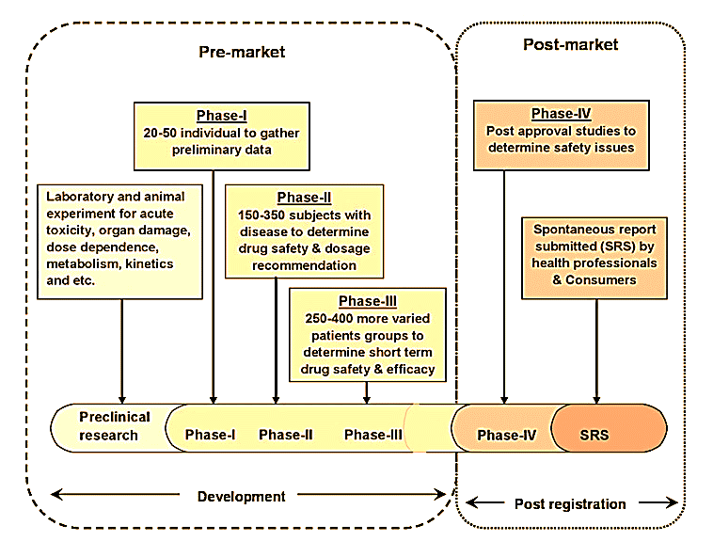
Four step involve in data mining of
pharmacovigilance
Premarketing surveillance
Post-marketing surveillance
Spontaneous Reports
Yellow Card Scheme

Slide 10
Haemovigilance Programme in india
Haemovigilance is a set of surveillance procedures covering the whole transfusion chain from the collection of blood and its components to the follow-up of its recipients intended to collect and assess information on unexpected or undesirable effects resulting from the therapeutic use of labile blood products and to prevent their occurrence and recurrence. It is an important tool for improving safe blood transfusion practices in a country.
The Haemovigilance Programme of India (HvPI) was launched on 10th December, 2012 in the country. The National Coordinating Centre of this programme is at National Institute of Biologicals, Noida and it is being implemented in collaboration with Indian Pharmacopoeia Commission with the budgetary support from Pharmacovigilance Programme of India.
India has become a member of International Haemovigilance Network (IHN) in December 2014. IHN was established in the Year 2009. Presently 33 Countries are members of International Haemovigilance Network including India. NCC- NIB has participated in General Assembly IHN via webinar on 27th March 2015, wherein an update about Haemovigilance Programme was apprised to the General Assembly IHN.

Slide 11
The challenges of PV in India
The biggest challenge facing the PVPI is the gross underreporting of adverse effects. There are many reasons for this, including lack of medical expertise in drug administration and adequate skilled resources in PV, and inadequate nationwide awareness of PV.
The other challenges are infrastructure which are still conservative, wide time interval between guidelines and laws, orthodox attitude to new drug research, and PV and regulatory inspections that are almost non-existent. The system needs to be refined with the help of PV experts in collaboration with information technology (IT) because India boasts of a highly developed IT sector.
Since PV deals with large numbers of ADRs, it would be wise for PV experts to collaborate with software professionals to develop and build a robust system. Software programs developed can be used for collection and analyses of data sets, determining trends of drug usage in various disease areas, compliance, medication errors and drug interactions leading to ADRs. Moreover, with more clinical research and PV outsourcing work now being conducted in India, it has been worthwhile for the DCGI to invest in a robust PV system to enable assessors and decision makers to analyze safety data and take regulatory decisions without the need to depend on other countries.

Slide 12
Future Prospective in India
As future prospective increase, PV systems are capable to detect new ADRs, and taking regulatory actions are needed to protect public health.
PV methods must also be able to describe which patients are at risk of developing an ADR.
In the future, Pharmacovigilance has to concentrate on the patients as a source of information in addition to the more traditional groups, such as the health professionals.
The aim of the PV is to receive the information, documentation of the work and knowledge online while giving priority to the new and important safety issues.

Slide 13
CONCLUSTION
The PV in India has become an important public health issue as regulators, drug manufacturers, consumers, and healthcare professionals are faced with number of challenges. The PV in India continues to grow, evolve, and improve.
It helps to identify factors that increase the risk of unwanted outcomes from drug therapy and prior to commencing drug treatment and in tailoring drug treatment for individual patients.
The PV has also involved in Data Mining Technology in spontaneous reports submit to the national surveillance systems.
The financial support and future projects should help to achieve a more comprehensive PV activity in India.

Slide 14
Thank
You !

